Slide 1

Campus Recruitment Management System
DAMG 6210: DATABASE MANAGEMENT AND DATABASE DESIGN
GROUP 1:
1. Hetal Atul Gada
2. Saniya Kapur
3. Kumar Mehul
4. Tanuj Verma

Slide 2
PROBLEM STATEMENT
Around 20,000 students attend a university
Lack of a centralized infrastructure for the students and employers
Managing on and off-campus employment is very time-consuming
To keep track of all parties, a comprehensive centralized database is required

Slide 3
Proposed Solution
PROPOSED SOLUTION:
Centralized System provided
System manages large datasets of on/off campus placements
Provides context on skills required in the market
Placement searching simplified

Slide 4
LIST OF ENTITIES:
LOGIN PORTAL
LOGIN CATEGORY
STUDENTWORKEXPERIENCE
STUDENTPROFILE
PLACEMENT APPLICATION
PLACEMENT LISTING
PLACEMENT TYPE
ORGANIZATION
ORGANIZATION FEEDBACK
PLACEMENT SKILLSETS
SKILLS
STUDENTSKILLSETS
DEGREE
STUDENT EDUCATION
PLACEMENT LOCATION

Slide 5

BUSINESS RULES:
Everyone should first create IDs via Login Portal
A Student can apply to many placement listings
An Organization should have at least one placement listing in the portal
A student may or may not have work experiences

Slide 6
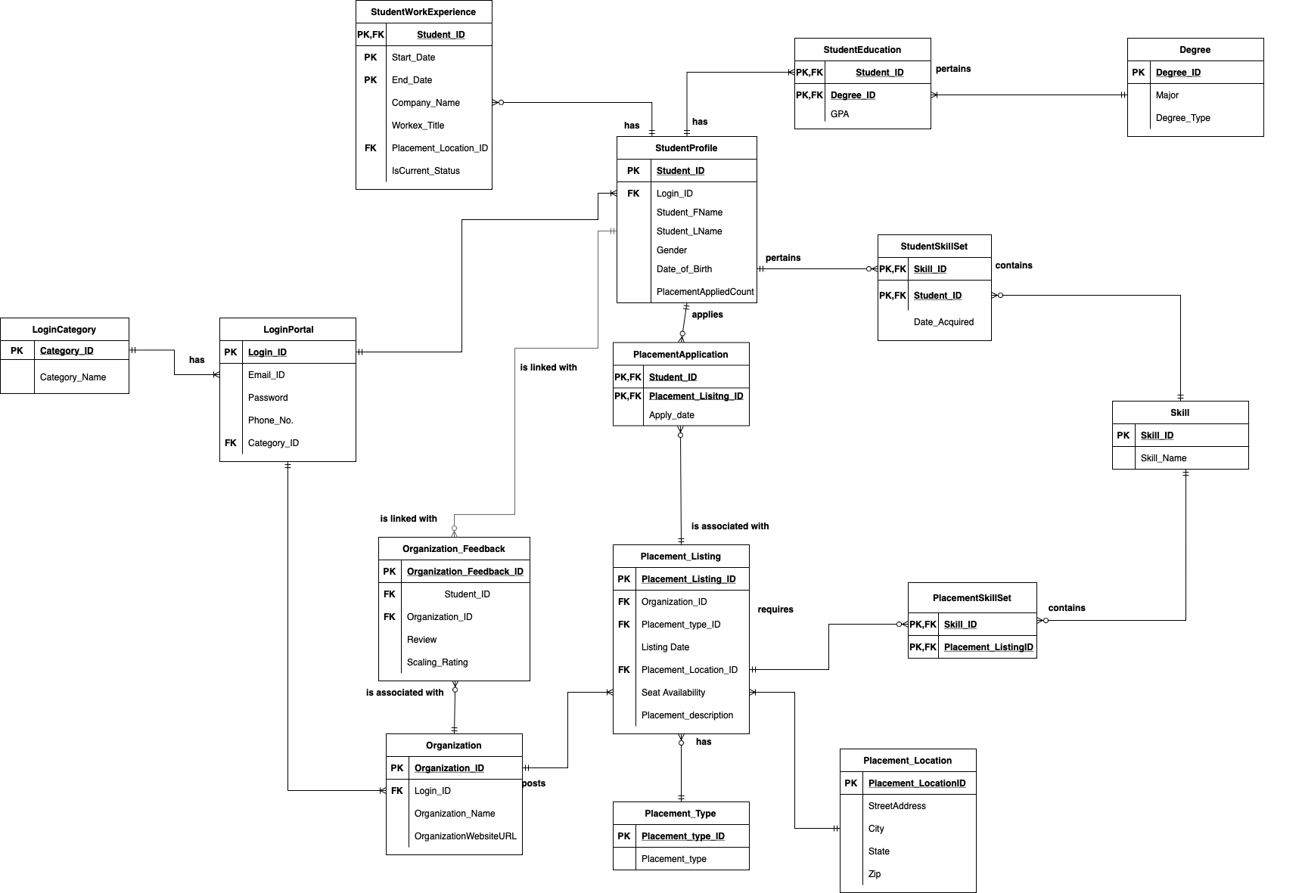
ER Diagram
ER DIAGRAM:

Slide 7

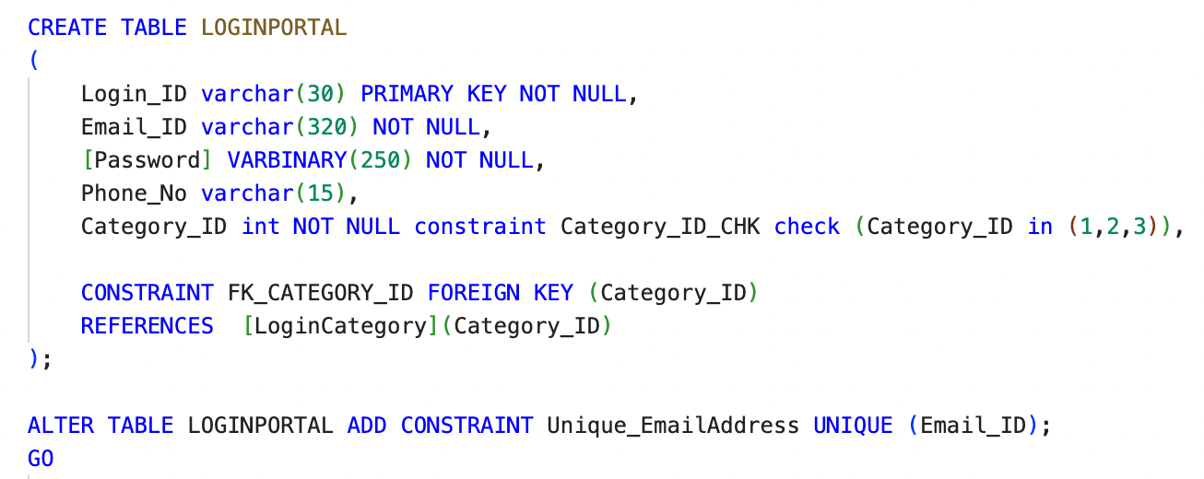
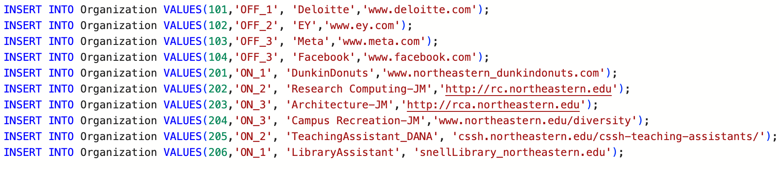
IMPLEMENTATIONS:
CREATING TABLE:
INSERTING VALUES:

Slide 8
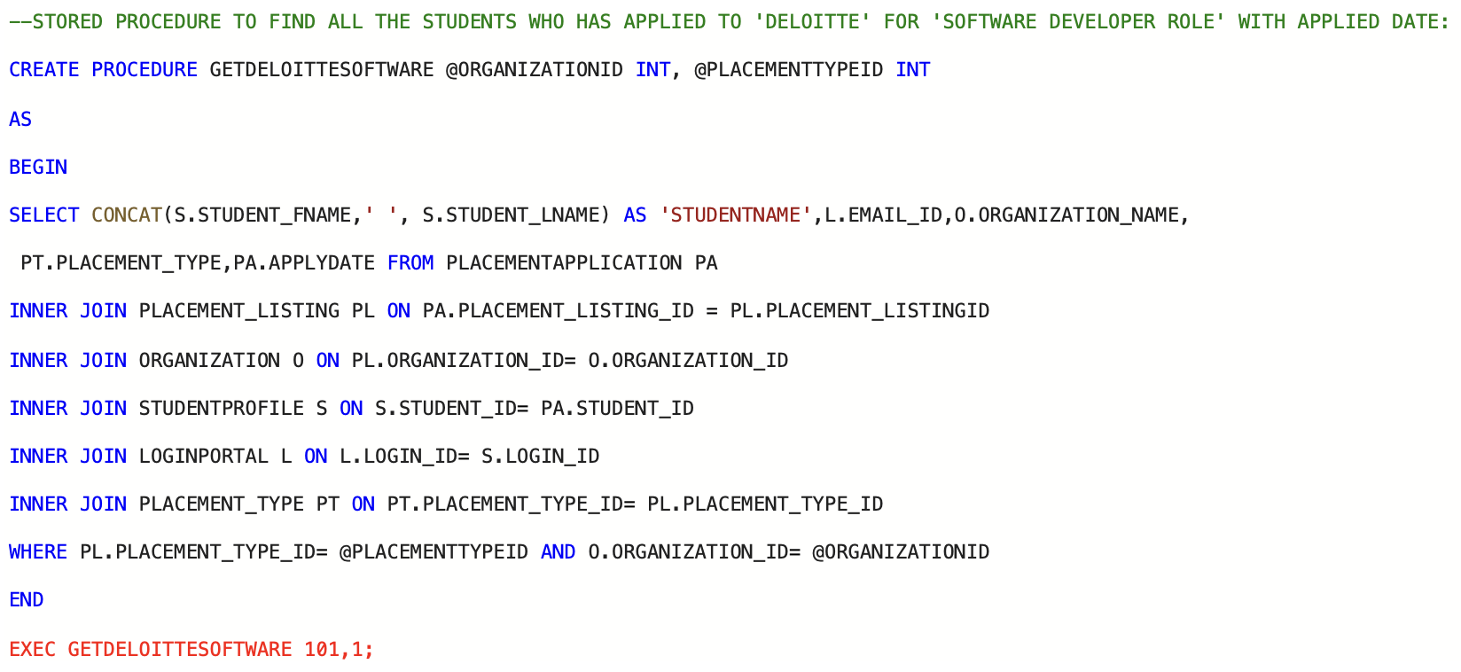
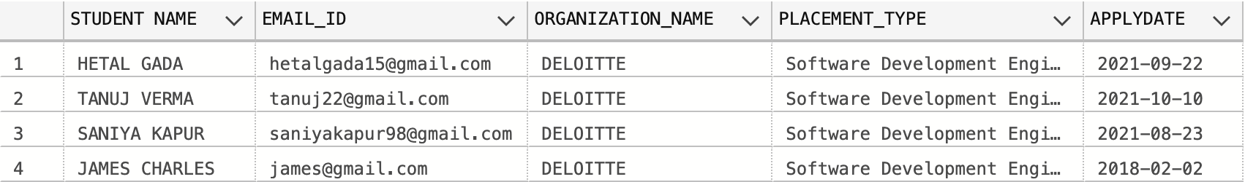
STORED PROCEDURES:

Slide 9
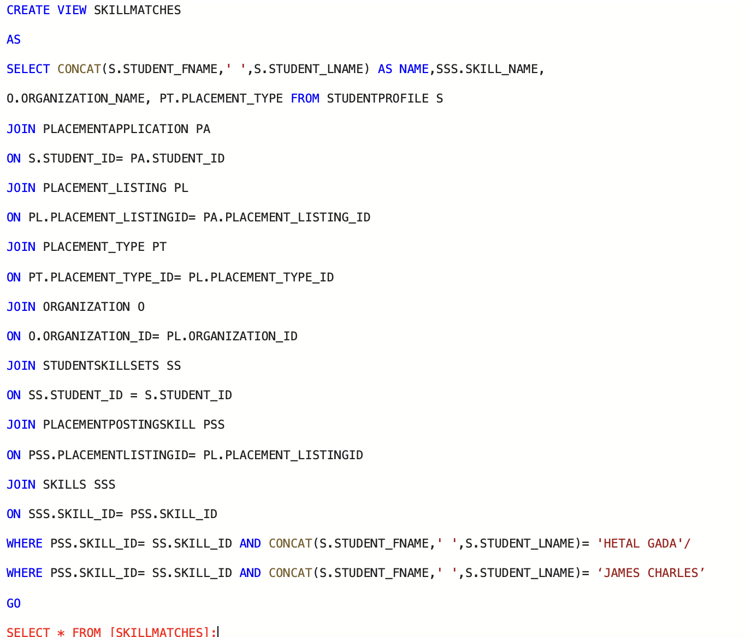
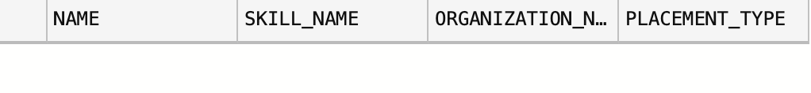
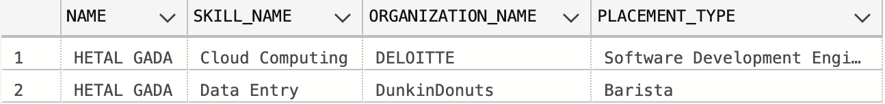
VIEW:
"FINDING THE ELIGIBILITY ACCORDING TO THE SKILLS"
FOR STUDENT NAME: "JAMES CHARLES"
FOR STUDENT NAME : "HETAL GADA"

Slide 10
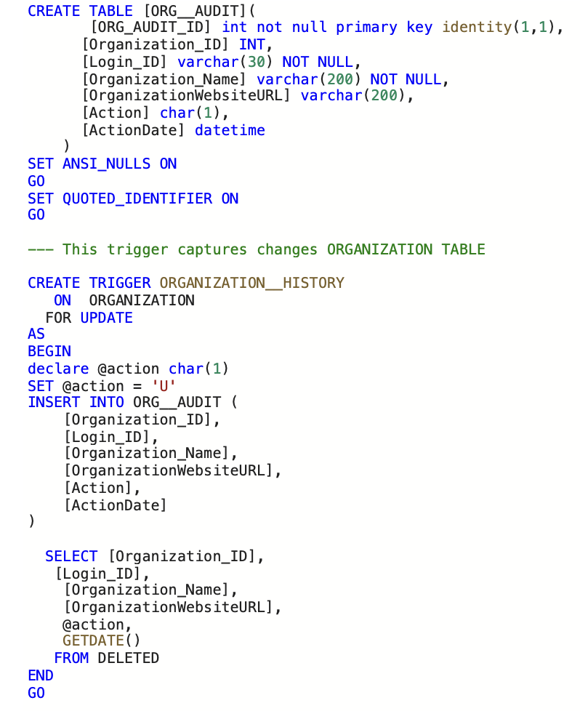
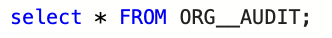
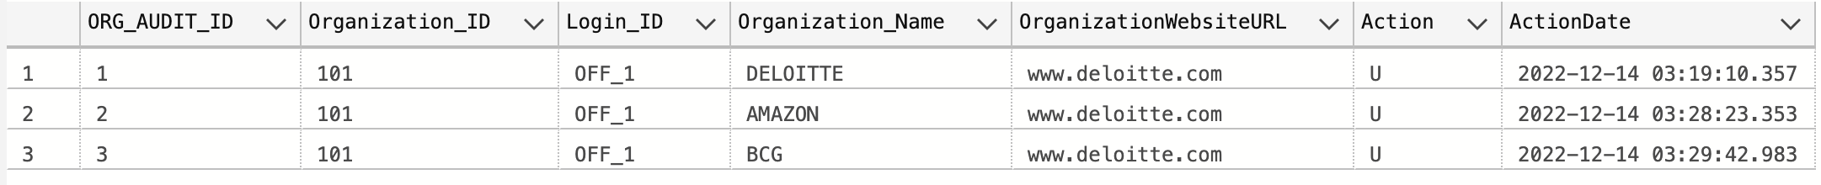
TRIGGER : 'UPDATING ORGANIZATION NAME'
'OUTPUTS:'

Slide 11
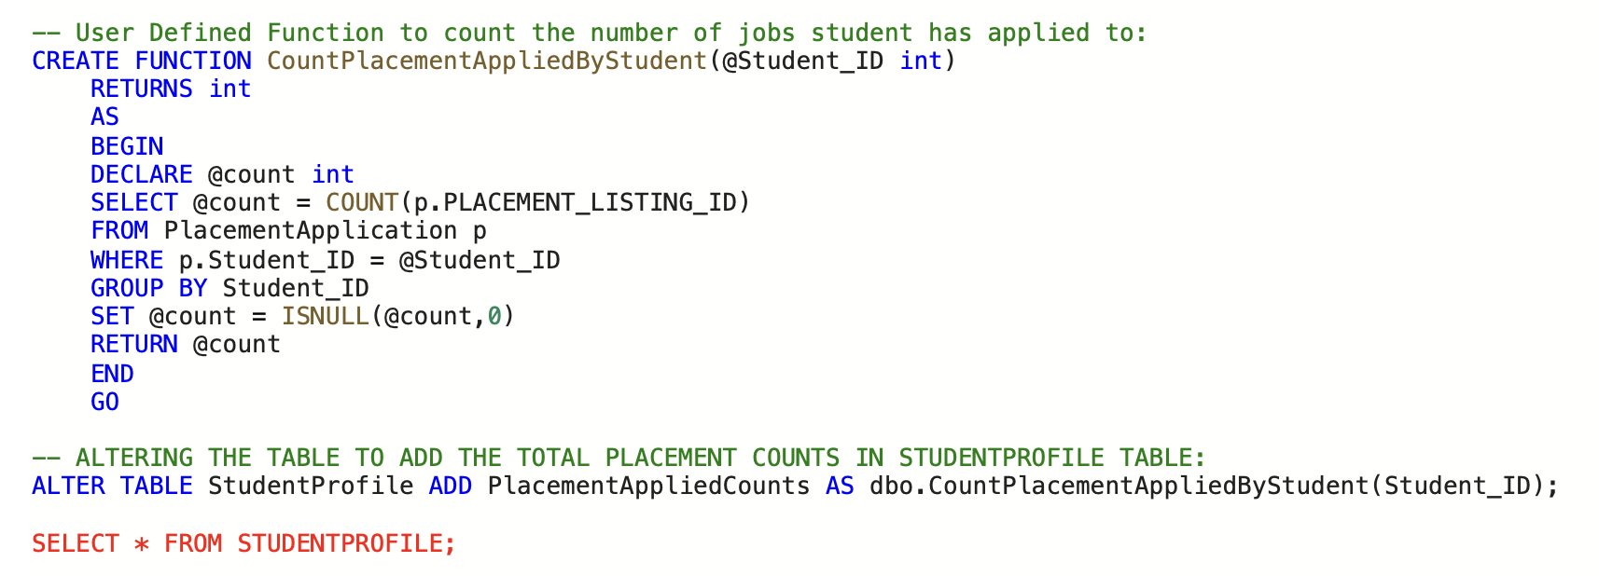
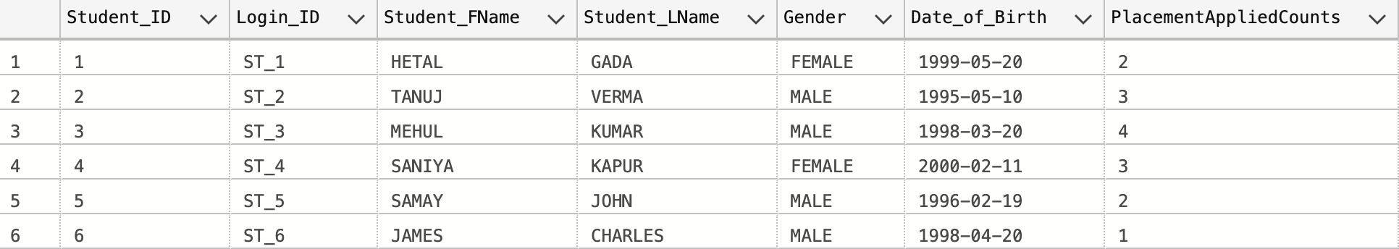
USER DEFINED FUNCTION:
OUTPUT:

Slide 12
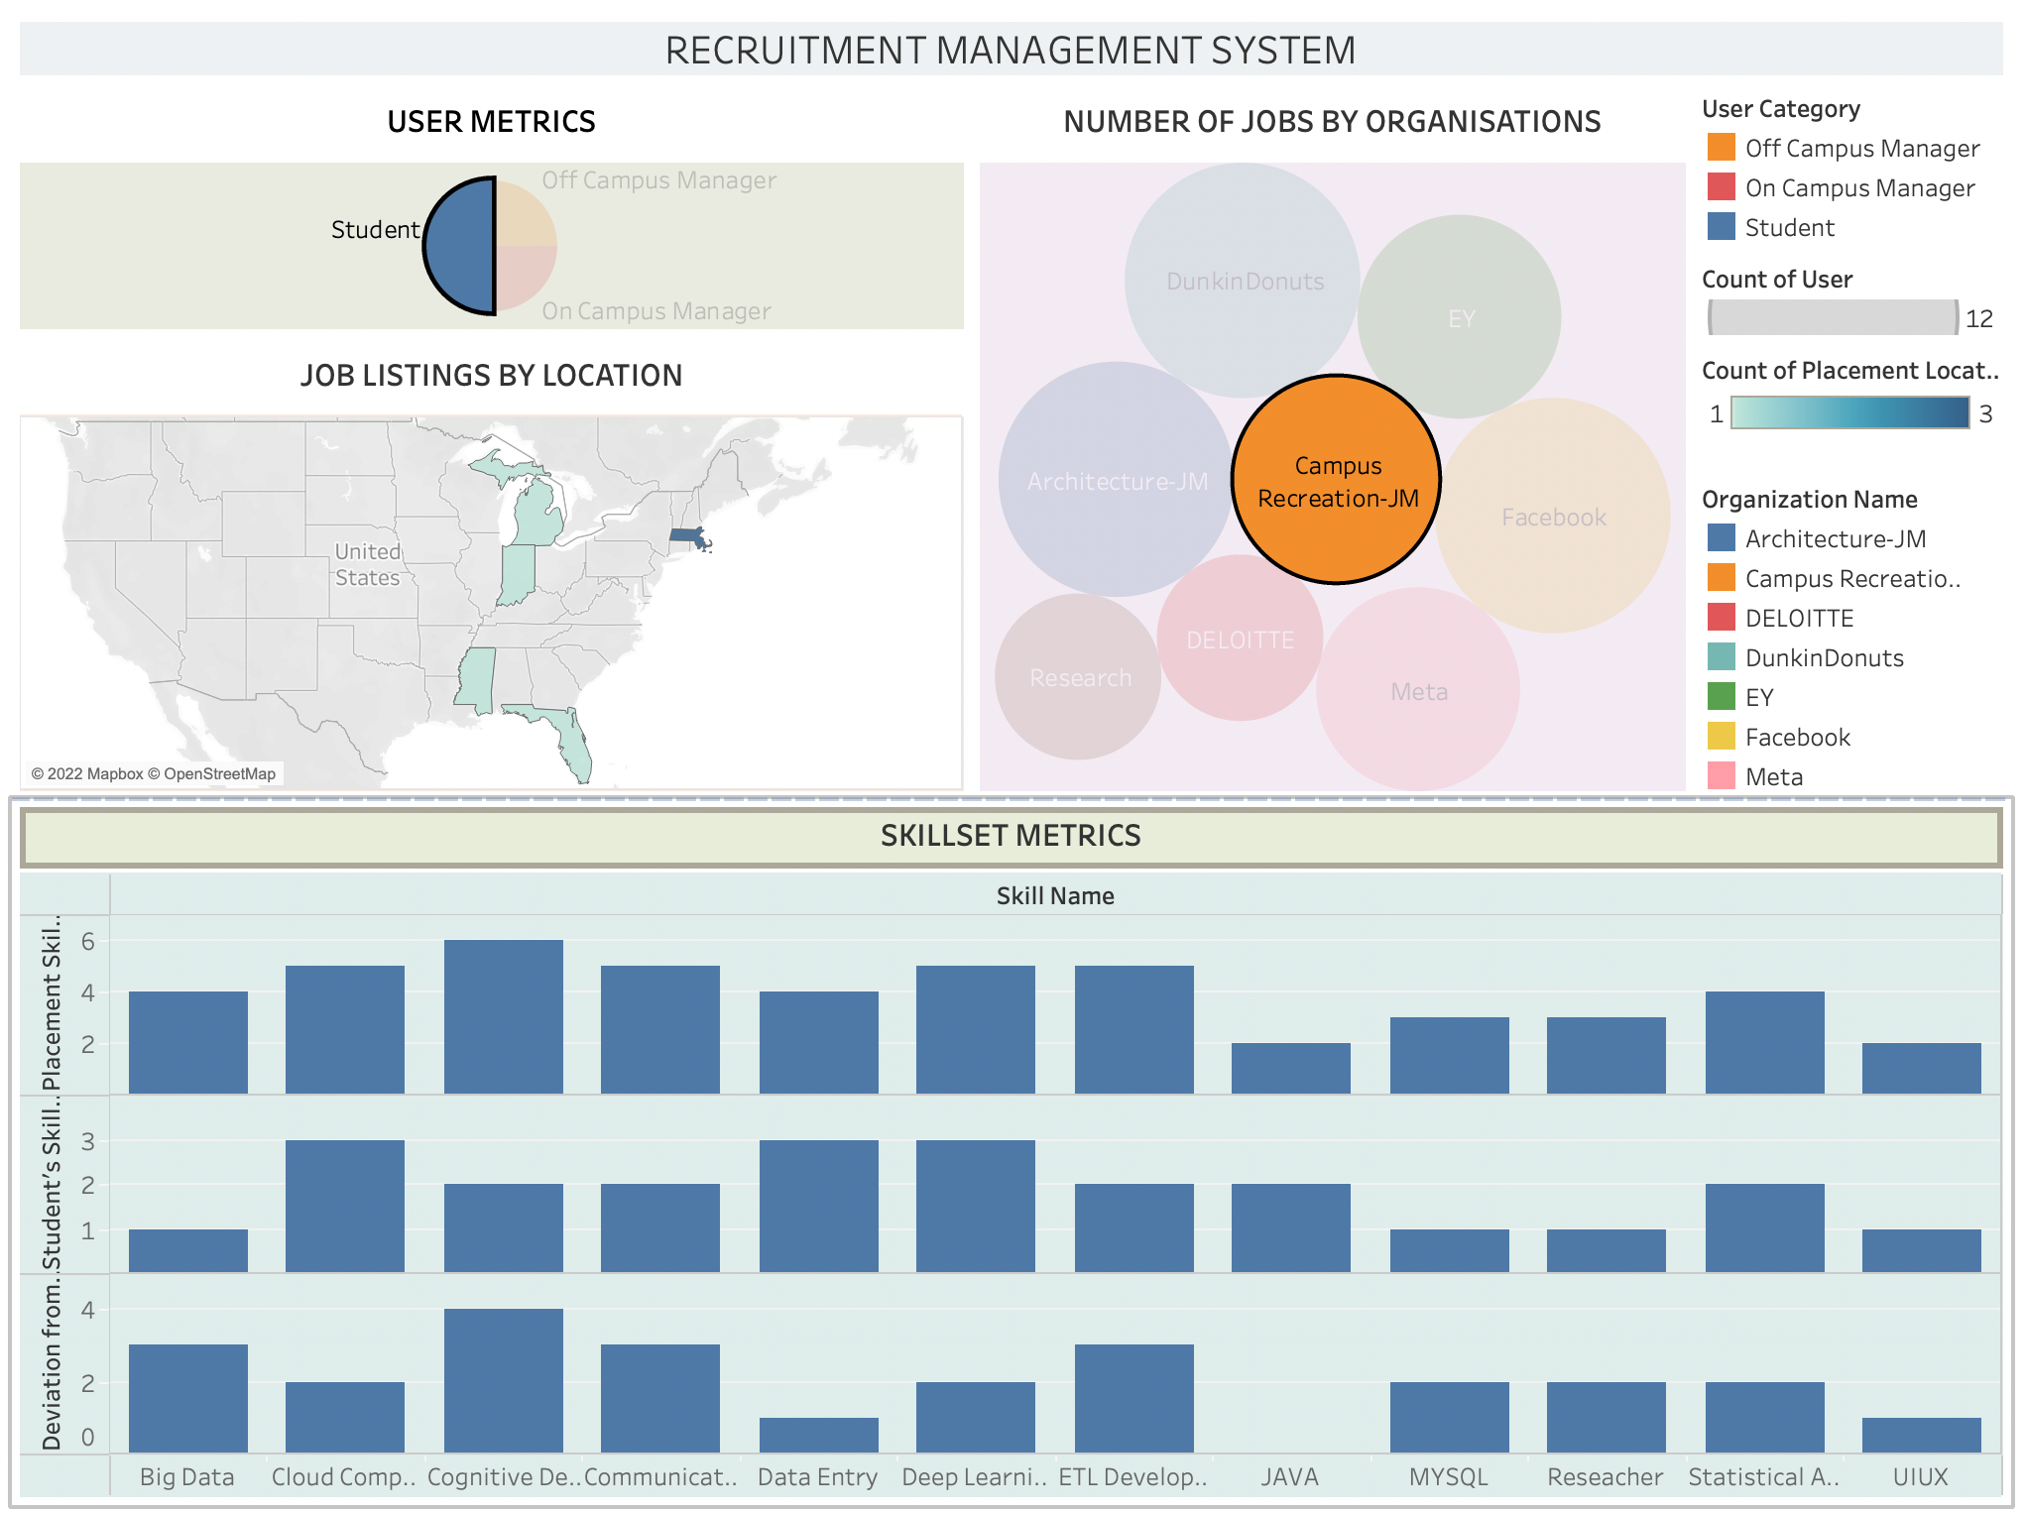
VISUALIZATIONS:

Slide 13
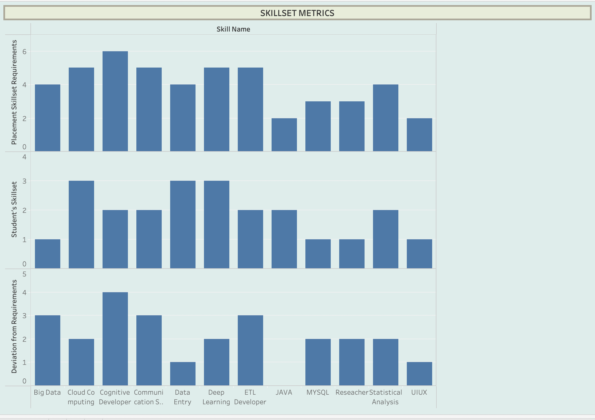
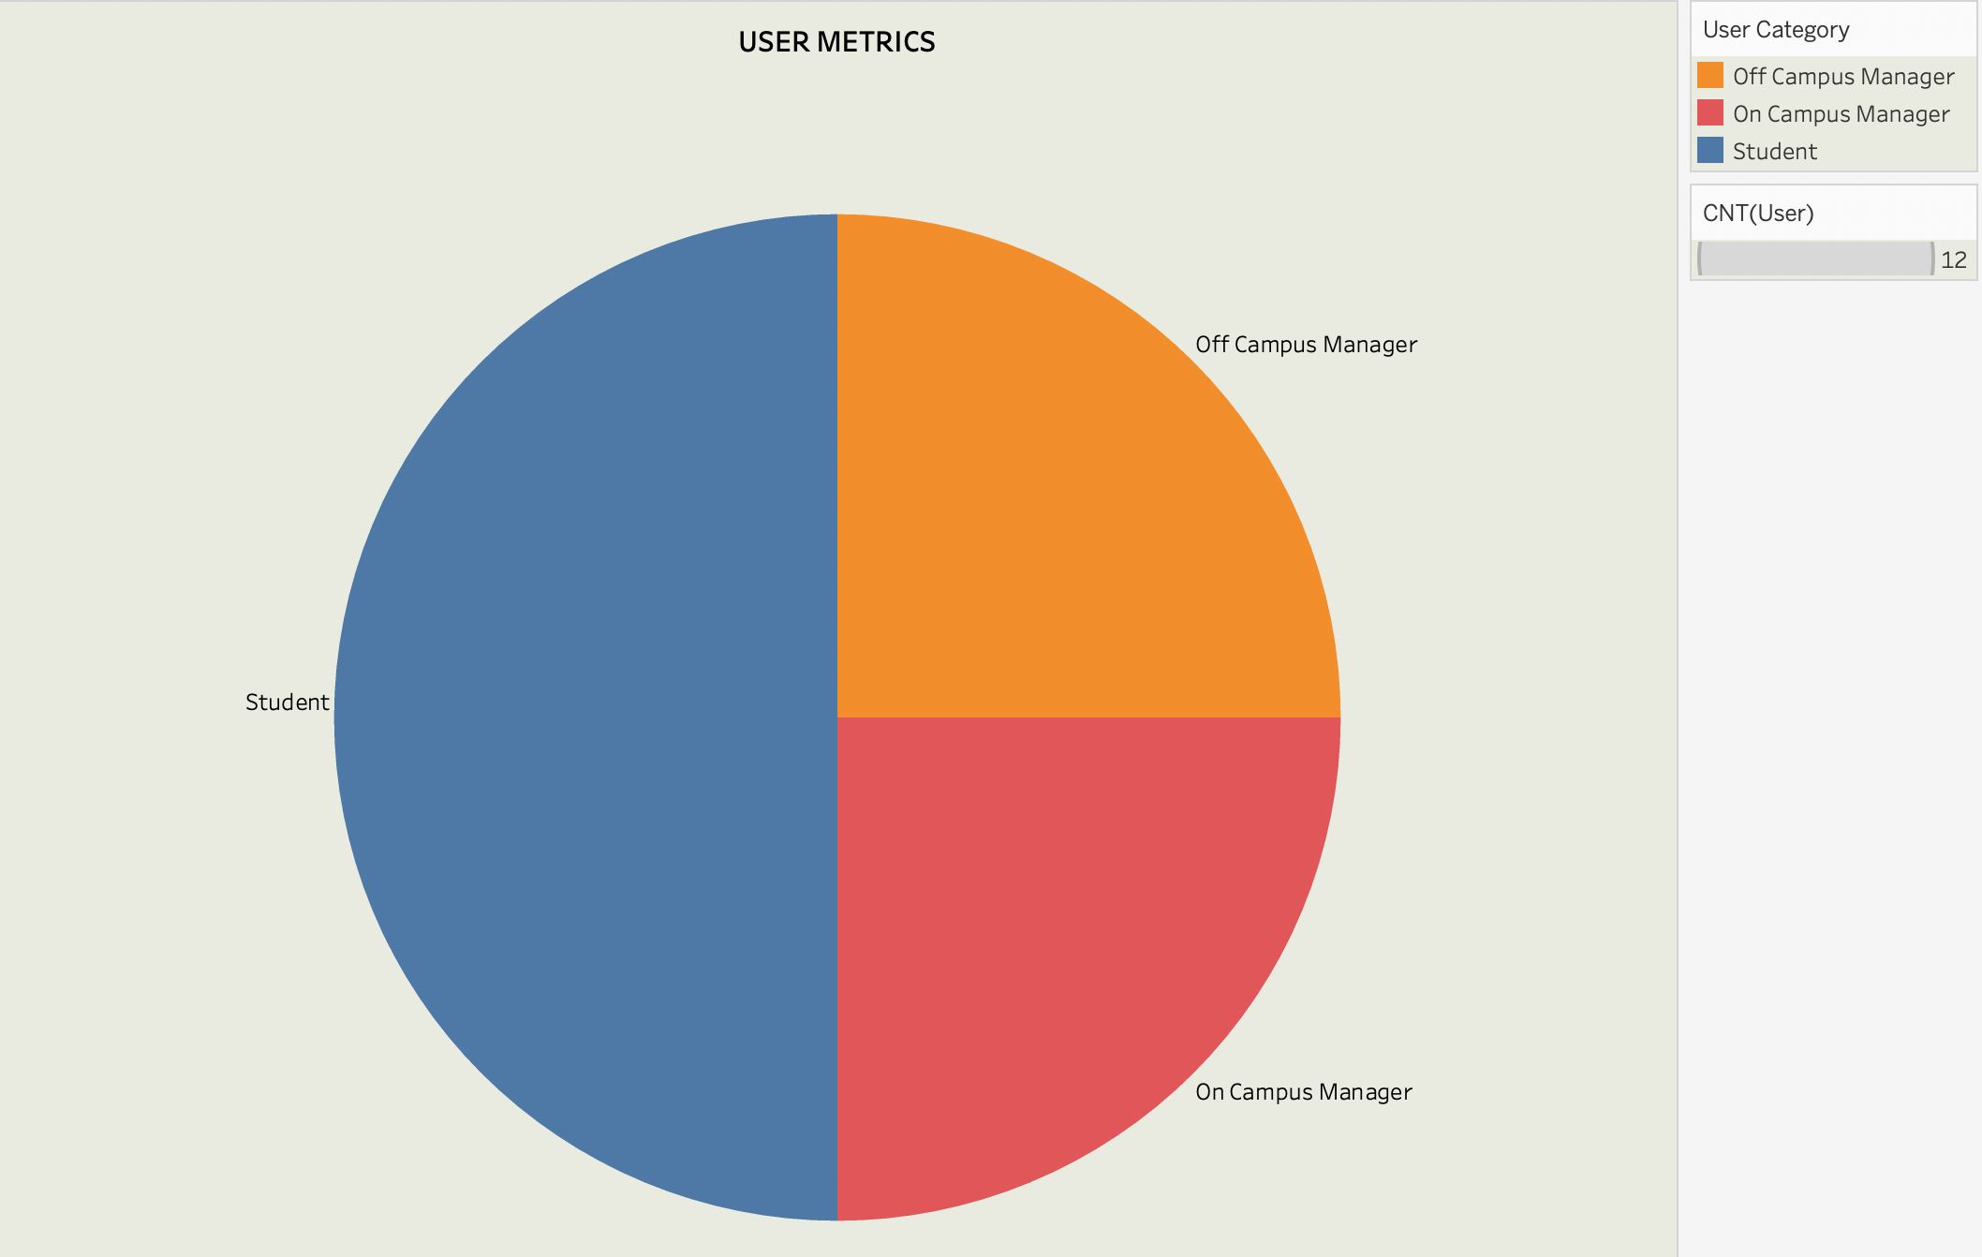

Slide 14
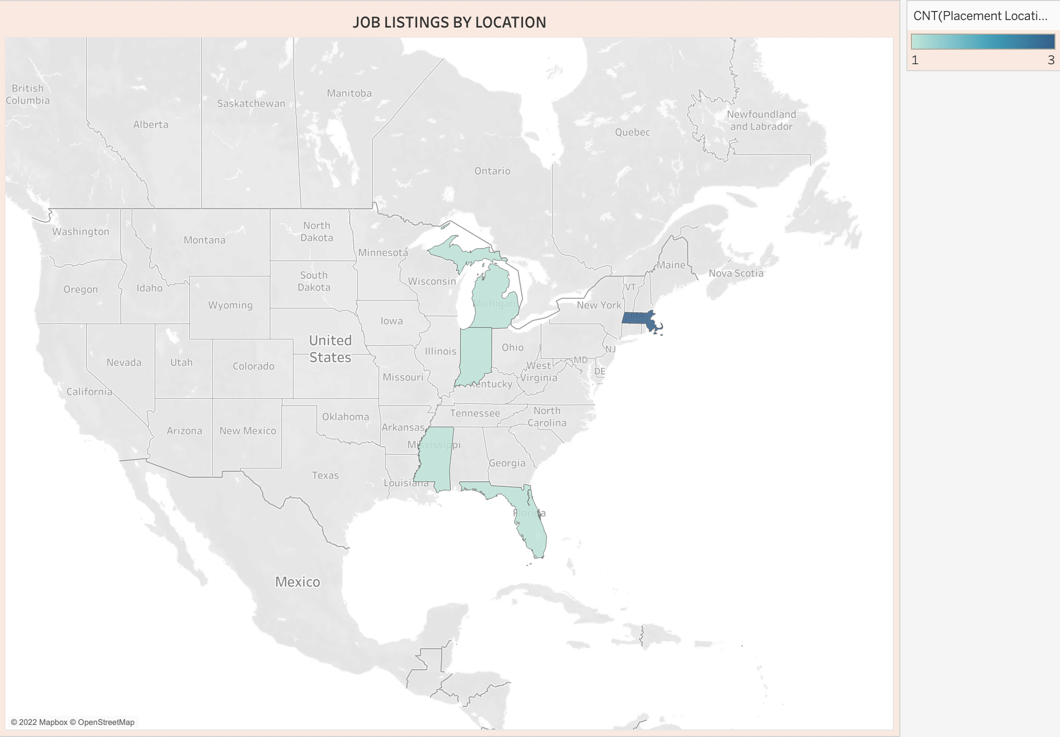
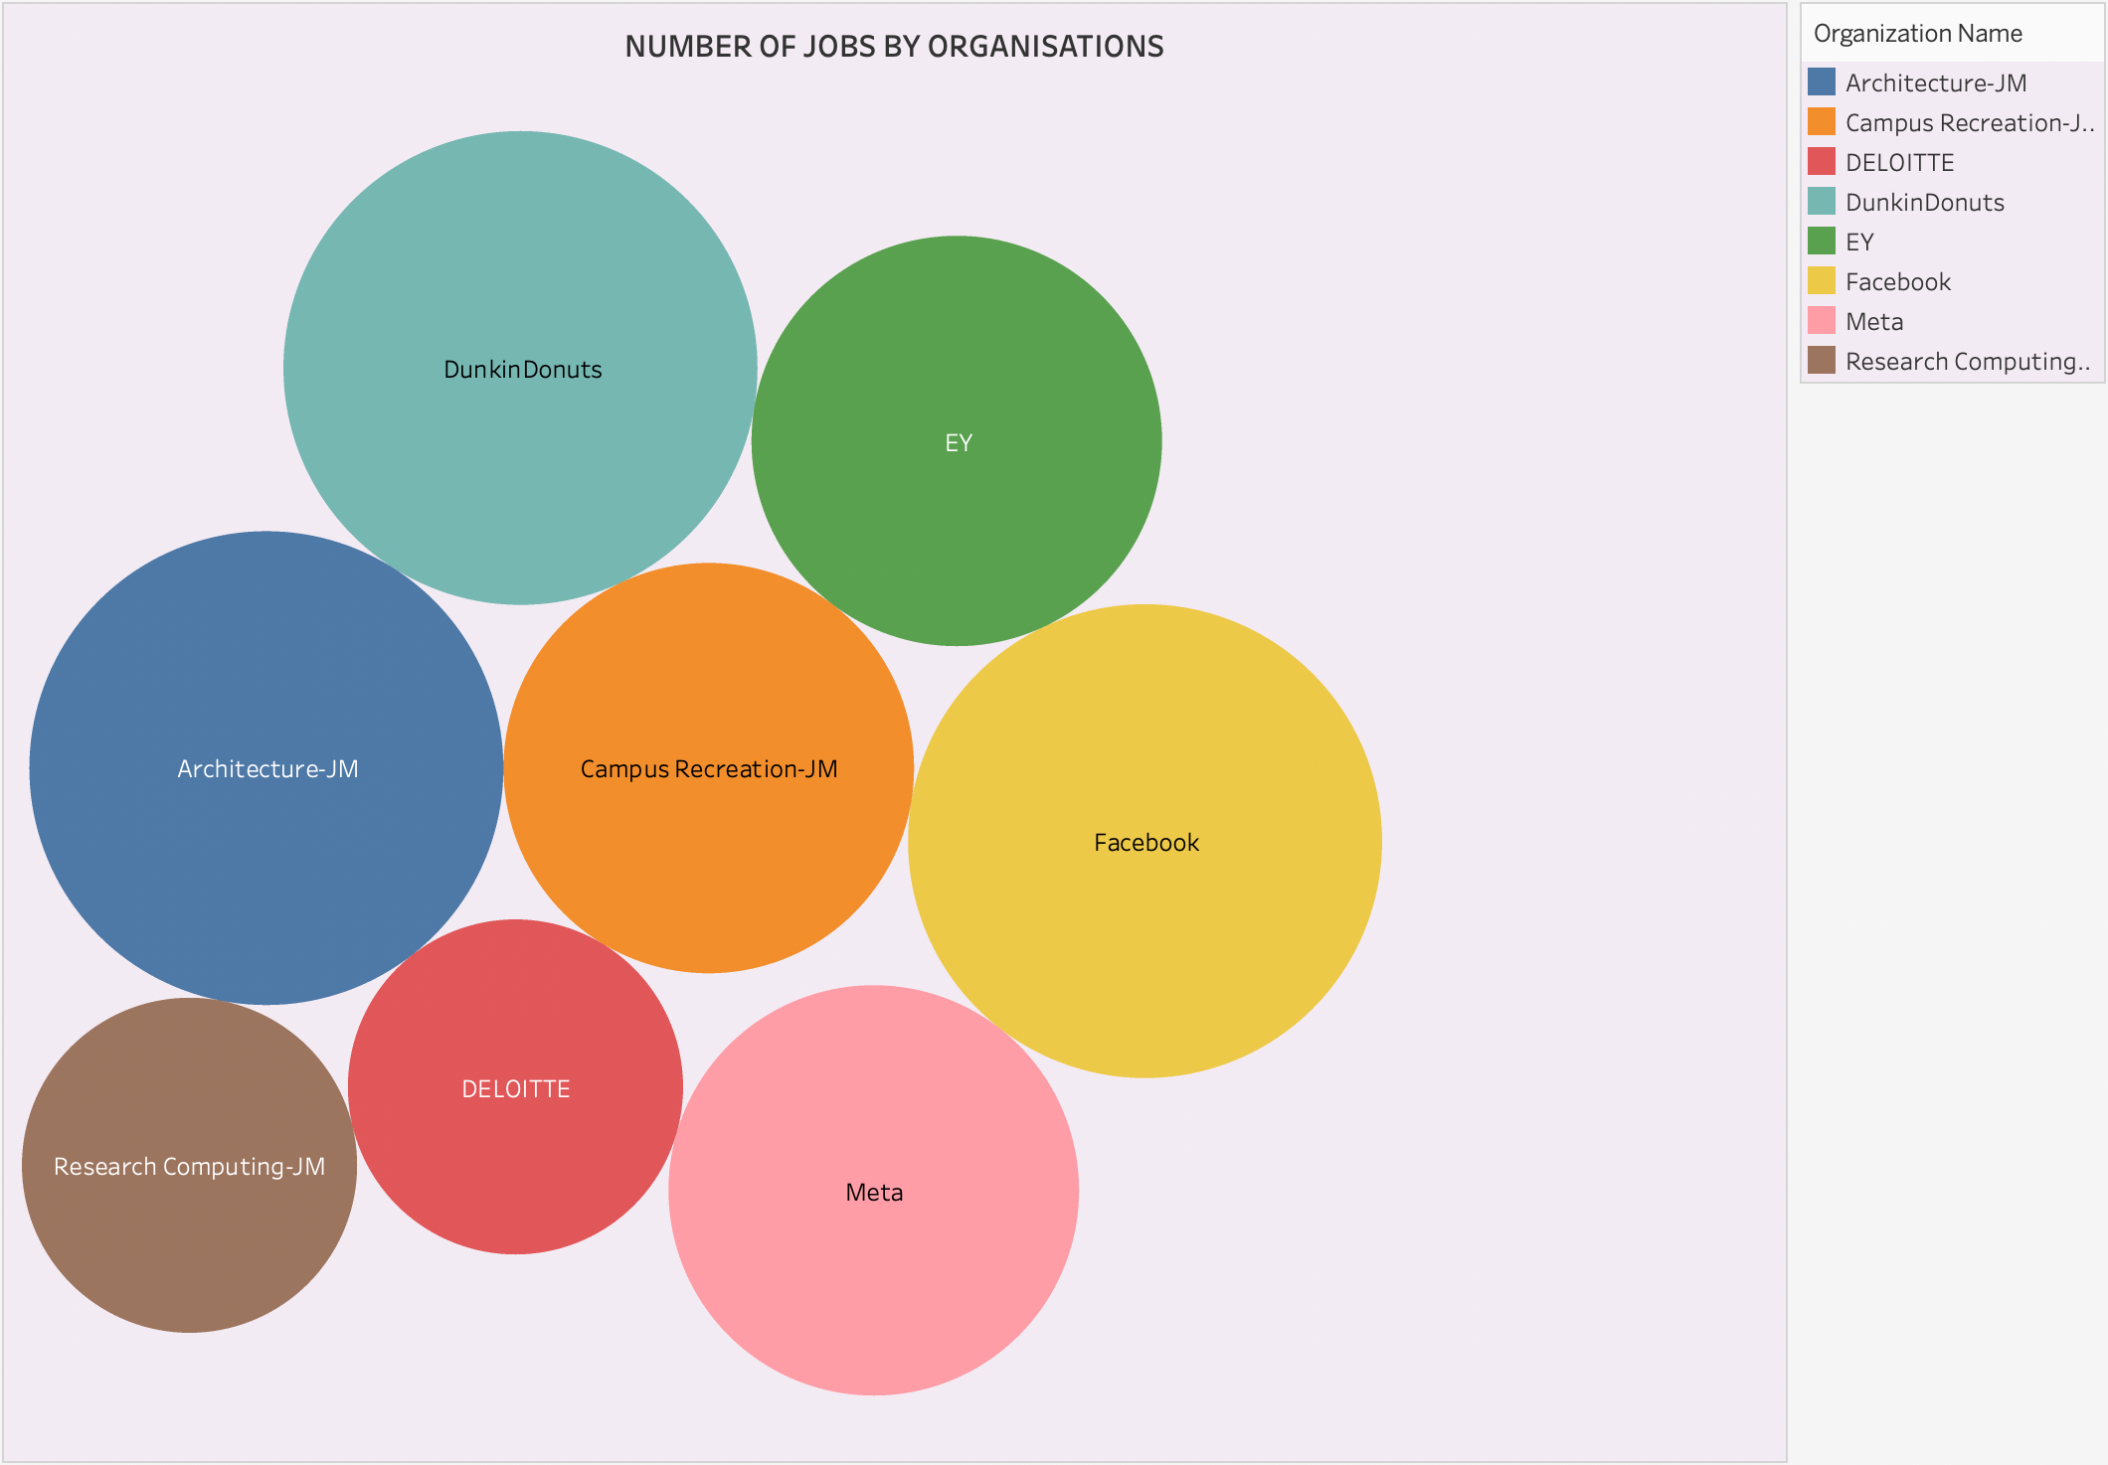

Slide 15

THANKYOU !

